Slide 1

MOUTH WIDE SHUT
Taylor Shearin
CSCI 3350-201
11/17/2014
Based on an article by Joel Spolsky

Slide 2
INTRODUCTION
“Every word I say, by definition, is a promise.”
  Marlon Brando, The Freshman
How can we apply this to software development?

Slide 3
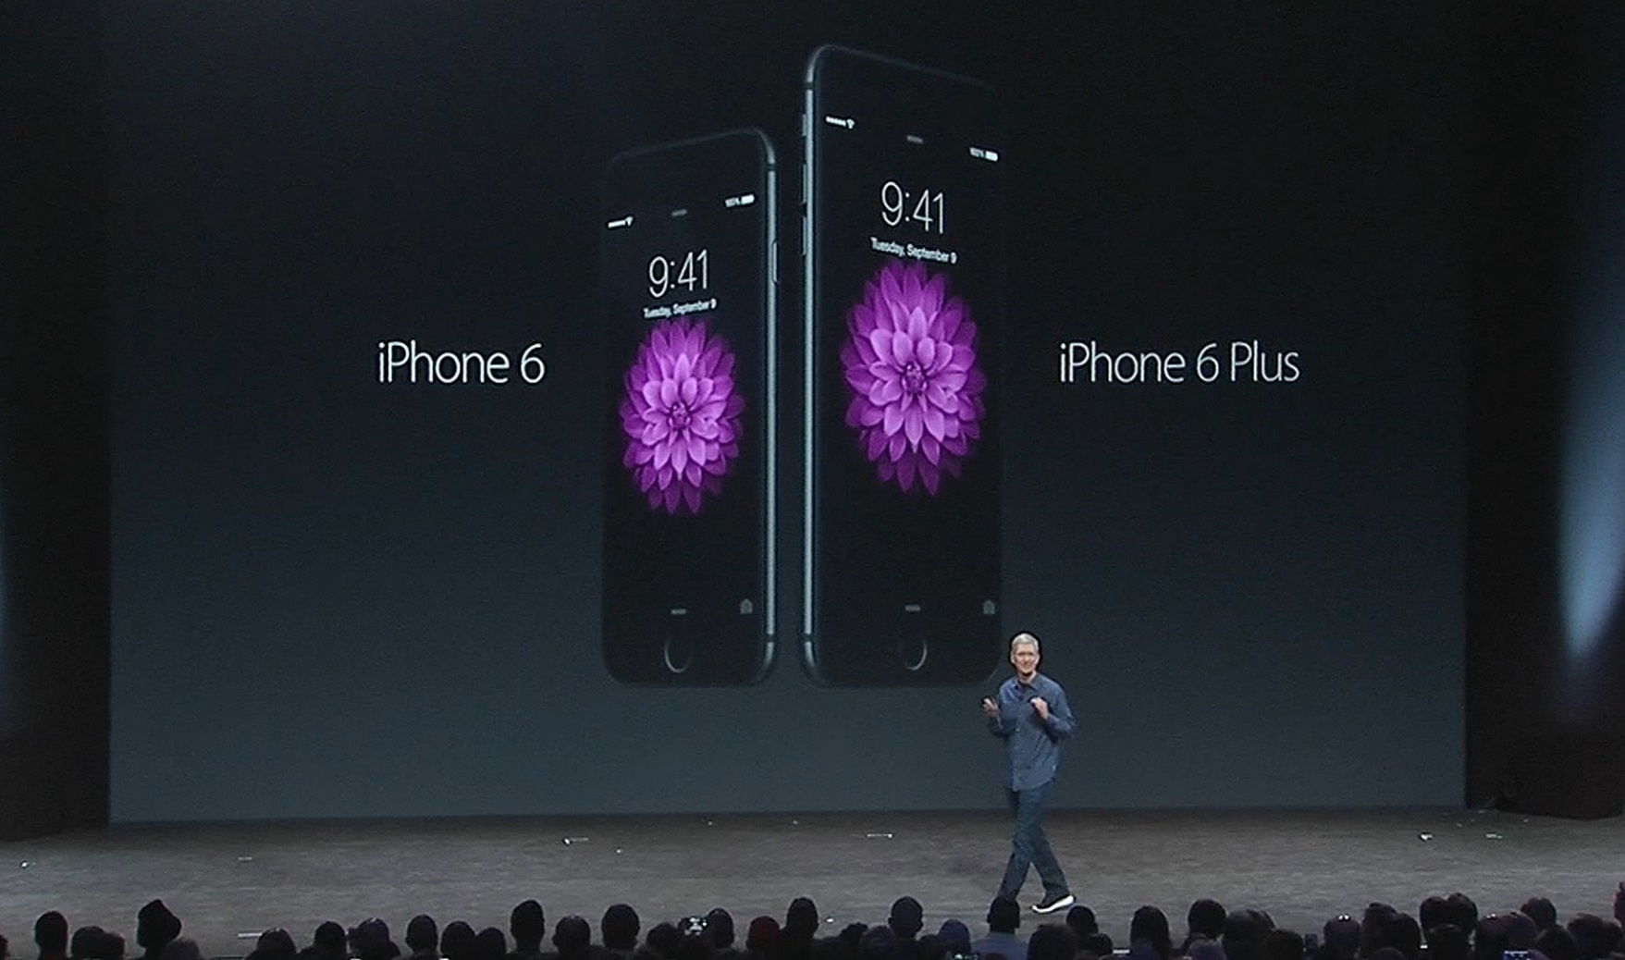
APPLE
Keeps information internal
Only reveals when ready
No early promises

Slide 4

MICROSOFT
s
Always discussing products
Developer previews
Xbox Monthly Patch videos
Always making promises

Slide 5

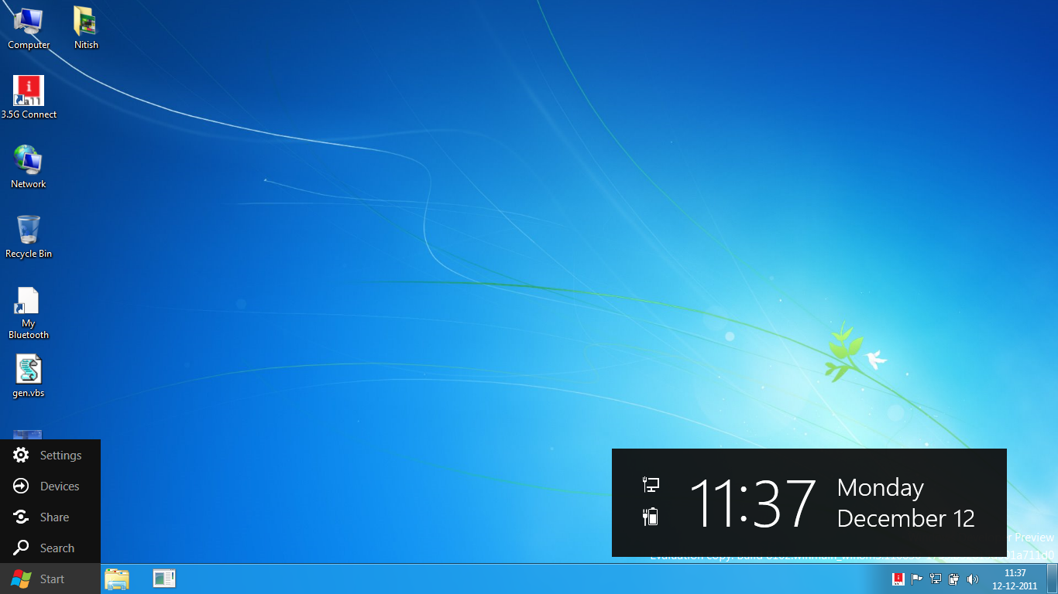
Windows 8 Developer Preview

Slide 6
COMPETITION
Talking about features
    Other companies may copy ideas
Microsoft playing catchup to Sony
  Daily Check-in
  Can’t share games
  System hardware
  System price

Slide 7
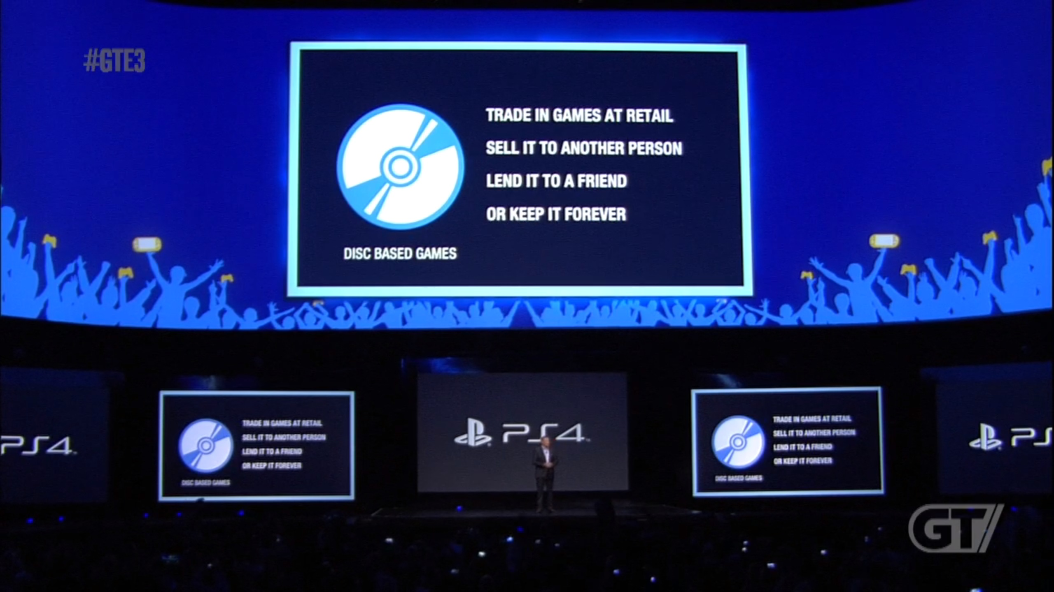
PLAYSTATION 4 REVEAL

Slide 8
PRODUCT SPECIFICATIONS
Underpromise and overdeliever
Otherwise
  Customer expectations spin out of control
  Hurts company when product is delivered
  Be careful not to oversell!

Slide 9
PRODUCT PROMISES
Keeping promises means being sure
  Look at Microsoft's behavior with Sony
  Not keeping promises costs reputation
    Hard to gain back

Slide 10
Leaks
Radio silence is easy to understand
  Anything else can result in accidental leaks from employees
Leaks eliminate flexibility
  Can ruin reputation

Slide 11
VALUE OF PUBLICITY
“I’m inclined to think that publicity that comes out when you can’t actually buy the product is 90% wasted.” -Joel Spolsky
Publicity can lead to early feedback
  Microsoft's Xbox One reveal wasn't well received
    Took negative feedback, and made a better product

Slide 12
Conclusion
Try to contain leaks
Underpromise and overdeliever
Early publicity is mostly wasted
Develop the application you want to, not what others are
  Don’t add features that don't agree with your vision
Questions?

